Slide 1
Binary Search

Slide 2
Binary Search Problem
Given a sorted array of integers and a target value, find out if target exists in the array or not
Input: arr[] = {3,4,6,7}, target = 4
Output: Target is in index 2
Trivial Solution: Linear Search O(n) Complexity

Slide 3
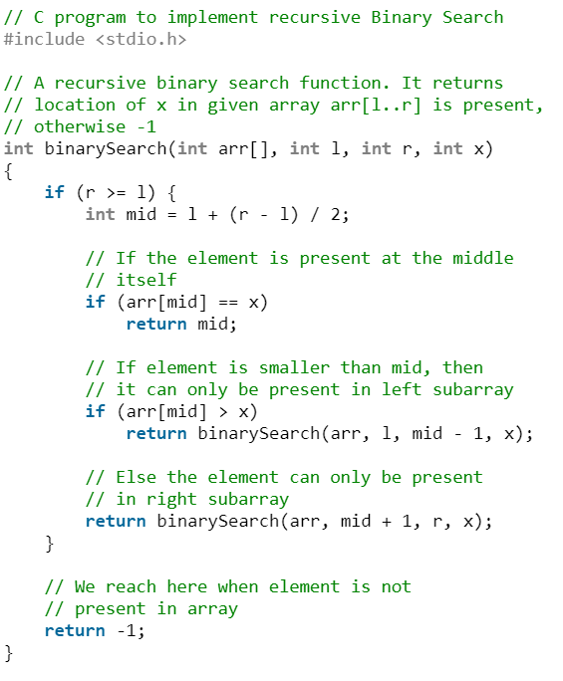
Binary Search Problem
Design O(logn) complexity algorithm
Divide & Conquer

Slide 4
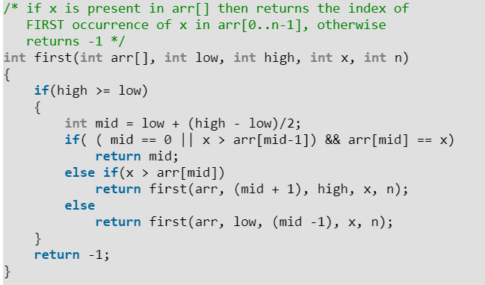
Problem: Find first occurrence of a given number in a sorted array
Trivial Solution: Linear Search O(n)
Modify Binary Search

Slide 5
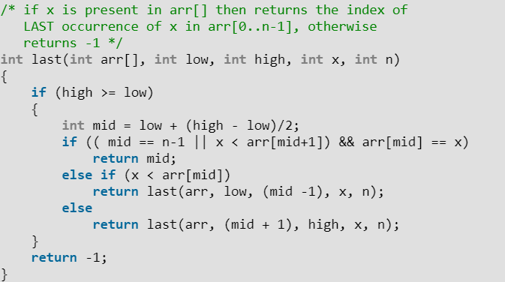
Problem: Find last occurrence of a given number in a sorted array
Trivial Solution: Linear Search O(n)
Modify Binary Search

Slide 6
Problem: Given a sorted binary array, efficiently find the number of 1s in it
Trivial Solution: Linear Search O(n)
Modify Binary Search
F = Index of First occurrence of 1
L = Index of Last occurrence of 1
Answer is L – F +1

Slide 7
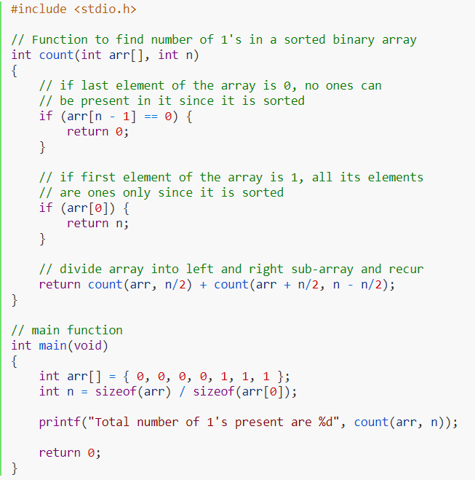
Another solution
Split array to 2 halves
Recurrence for both halves
If last element of the sub-array is 0, then all elements are 0 since already sorted
If first element of the sub-array is 1, then all elements are 1 since already sorted

